Slide 1
CT7121 Python Notebooks and Scripting
Week 7

Slide 2
Python Files
We’ve been mostly using python notebooks, with the extension *.ipynb. But this isn’t the only way (or even the main way) to code in Python.
A lot of python coding involves using *.py files – python script files. These are basic text files – they don’t work like notebooks – when you run a script all the code in it is just run top to bottom without stopping.
Because of this, you tend to code in a different way in script files, using a lot of functions to control the flow of the program, as you can’t control it manually using shift+enter.
You need an editor such as VS-Code for these kinds of files – jupyter will allow you to edit these files, but doesn’t give a very good environment for doing so.

Slide 3
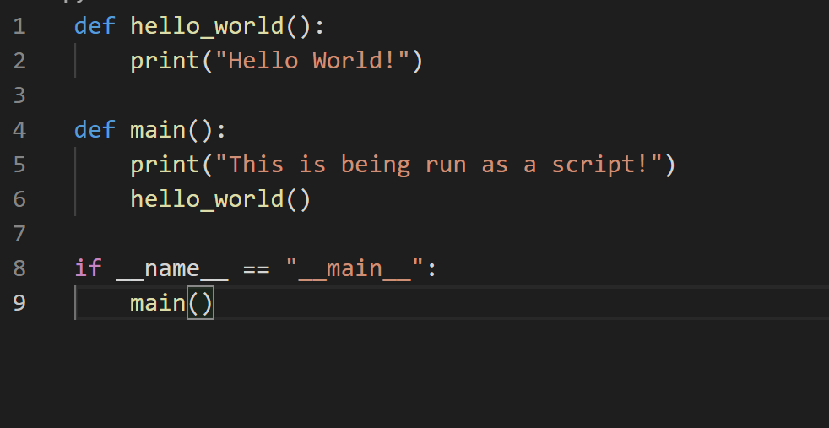
Writing a script and main
This is how you would write a script to be run directly from the command line, via running “python test.py”.
The if statement at the bottom is the only code outside of a function.
This if statement accesses a private attribute of the script itself, automatically generated by the python interpreter, and checks whether the name generated is “__main__”.

Slide 4
Writing a script and main
This “__main__” name is what python assigns to any script run directly, so it can be used to identify when the script has been run directly – and call the “main” function which is designed to be an entry point into the program.

Slide 5
So.. How else can they be run?
We’re talking about running python code directly from the command line, as if there were another way to run it – so what would that other way be?
You can pull a .py file into your own code (either another .py file or a .ipynb notebook) using the import statement – in fact this is how simple libraries work.

Slide 6
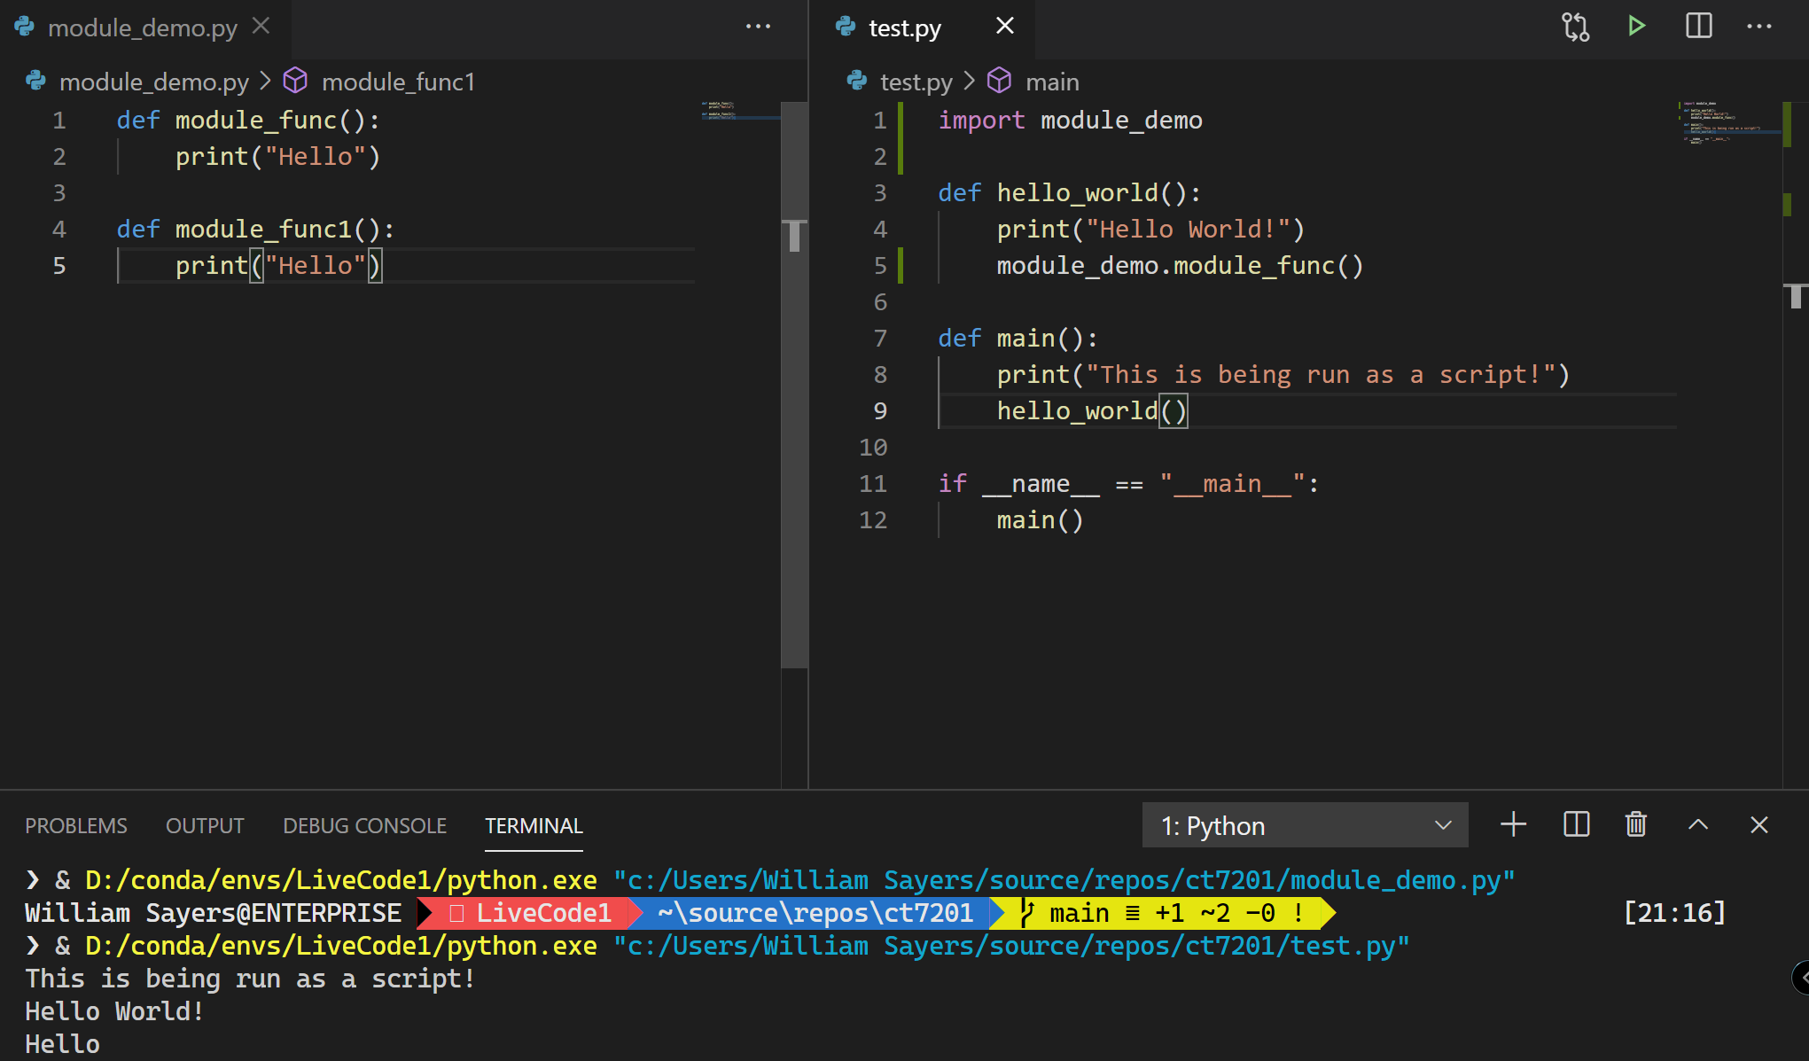
Example

Slide 7
More importing..
You can also import specific parts of a file (so you don’t need to preface the functions/classes you’re using with the module name).

Slide 8
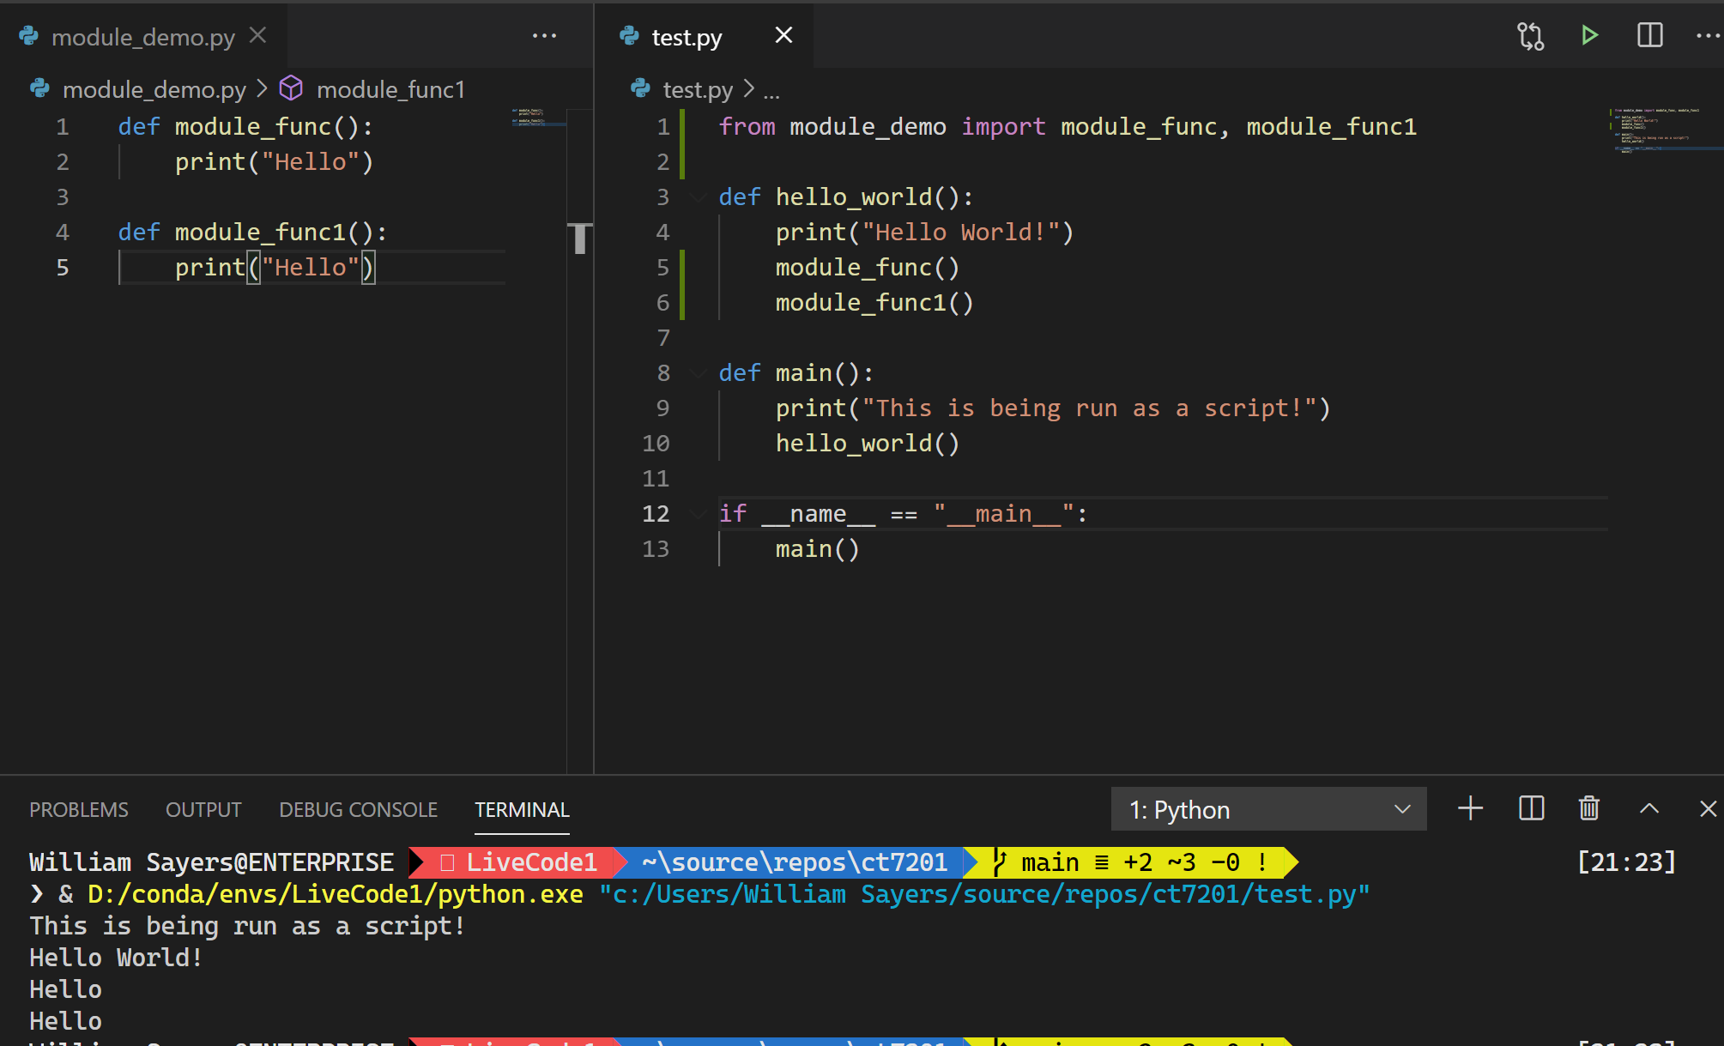

Slide 9
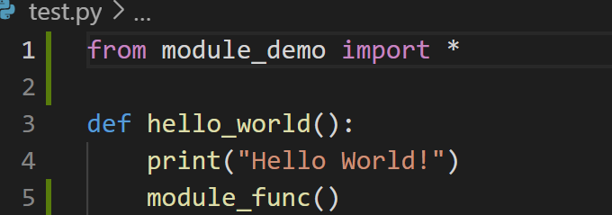
More importing..
Or just import * (wildcard). This imports everything from a module – this is generally frowned upon in the python community, because it can pollute the global namespace.
When coding in notebooks, the rules can be bent slightly for convenience – because your notebook code isn’t likely to be deployed to production – but if you later need to streamline your code for deployment one step should be replacing any global imports with specific ones

Slide 10
Points to note
This approach for code sharing works provided everything is within one directory – so I would recommend you code like that. Makes things easier.
It’s worth noting as well that code can both have a main function and the if statement to make it work – and be used as a module. This is often quite useful for debugging – you can write a main function which tests all your functions work, so that you can just run the file to test it – and then import it as a library and use those same functions from elsewhere.

Slide 11
Useful third party libraries
We’ll have a brief look at some useful libraries, that may come in handy during your assignment.
The focus for this module is on your python coding ability rather than your analysis – will be looking for things like extracting information, constructing your own data types to store information, printing out useful information in text – you can use these libraries if you wish to help ( and get some early practice ) but they are not required.

Slide 12
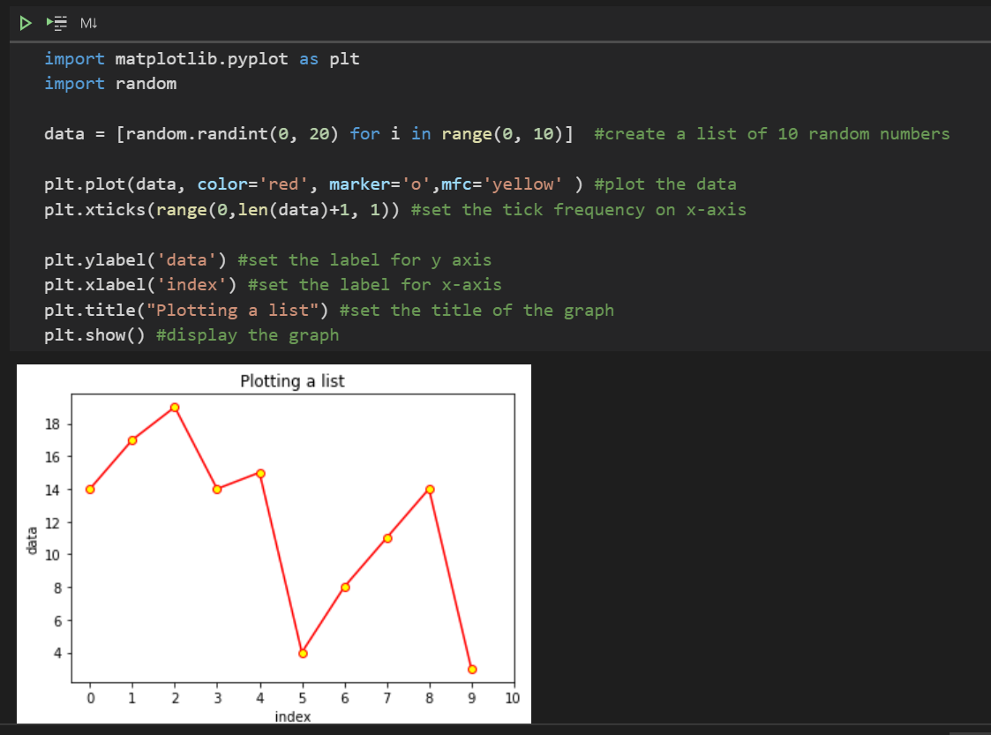
Matplotlib
Matplotlib is a library for creating plots of data – it can be used in notebooks and in ordinary python files (where it can output a graphic to disc).

Slide 13

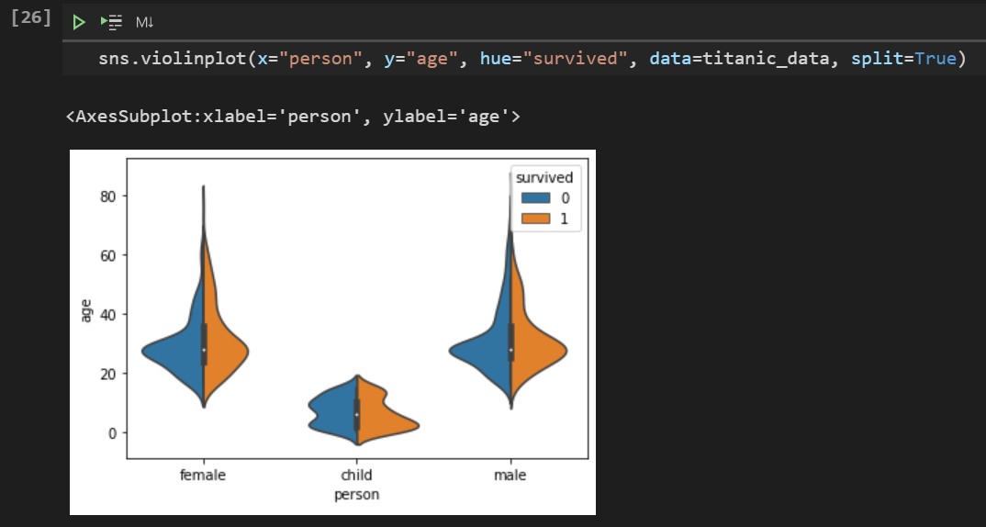
Seaborn
Seaborn is a library which sits on top of matplotlib (uses matplotlib) and gives a few easy ways to make impressive graphs, that otherwise would need a substantial amount of matplotlib coding to replicate.

Slide 14

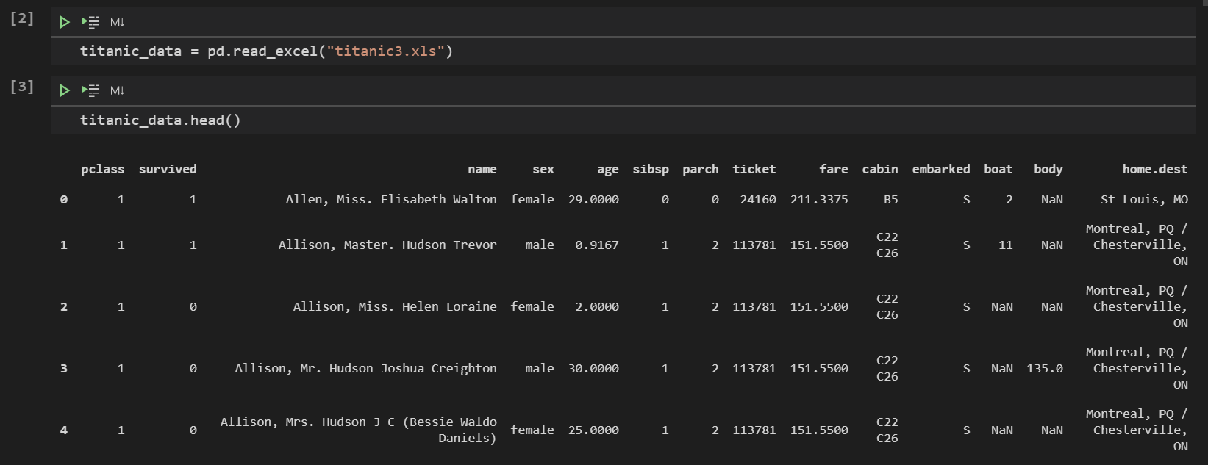
Pandas
Pandas is used for loading and manipulating data – it is very powerful although it has performance issues with very large datasets due to its single-threadedness.

Slide 15
Tutorial
Break into your assignment teams
Sign up to Kaggle – and investigate what datasets are available
Find a dataset that you find interesting – should be tabular data i.e. excel-like, not image recognition data etc (which would just be lots of images) – you may use the titanic set if you wish
Load this into python and try out some of the graphs and libraries shown today – also have a go at generating some stats manually via python rather than just using libraries (i.e. mean of a column, median of a column, etc).

